Slide 1

DSI Capstone
​Movie Recommendations And Genre Predictions
Katerina Capouskova

Slide 2

The Aim:
When looking at Netflix, I often look only on titles and infer the genres so I asked:
Can a model predict genre from a movie title?
And when I like couple of movies, I want to watch similar ones so I asked another question:
Can a model recommend me movies according to my previous likes?

Slide 3
The Data:
ratings.csv
24 million ratings (long format by user ID)
movies.csv
40 thousand movies (wide format by movied ID, genres)
tags.csv
668 thousand tags (long format by movie ID)

Slide 4
Genres:
Comedy
Drama
Romance
Mystery
Thriller
Horror
Film-noir
Musical
Fantasy
Documentary
Adventure
Animation
Children’s
Western
War
Crime
Sci-Fi
(IMAX)

Slide 5
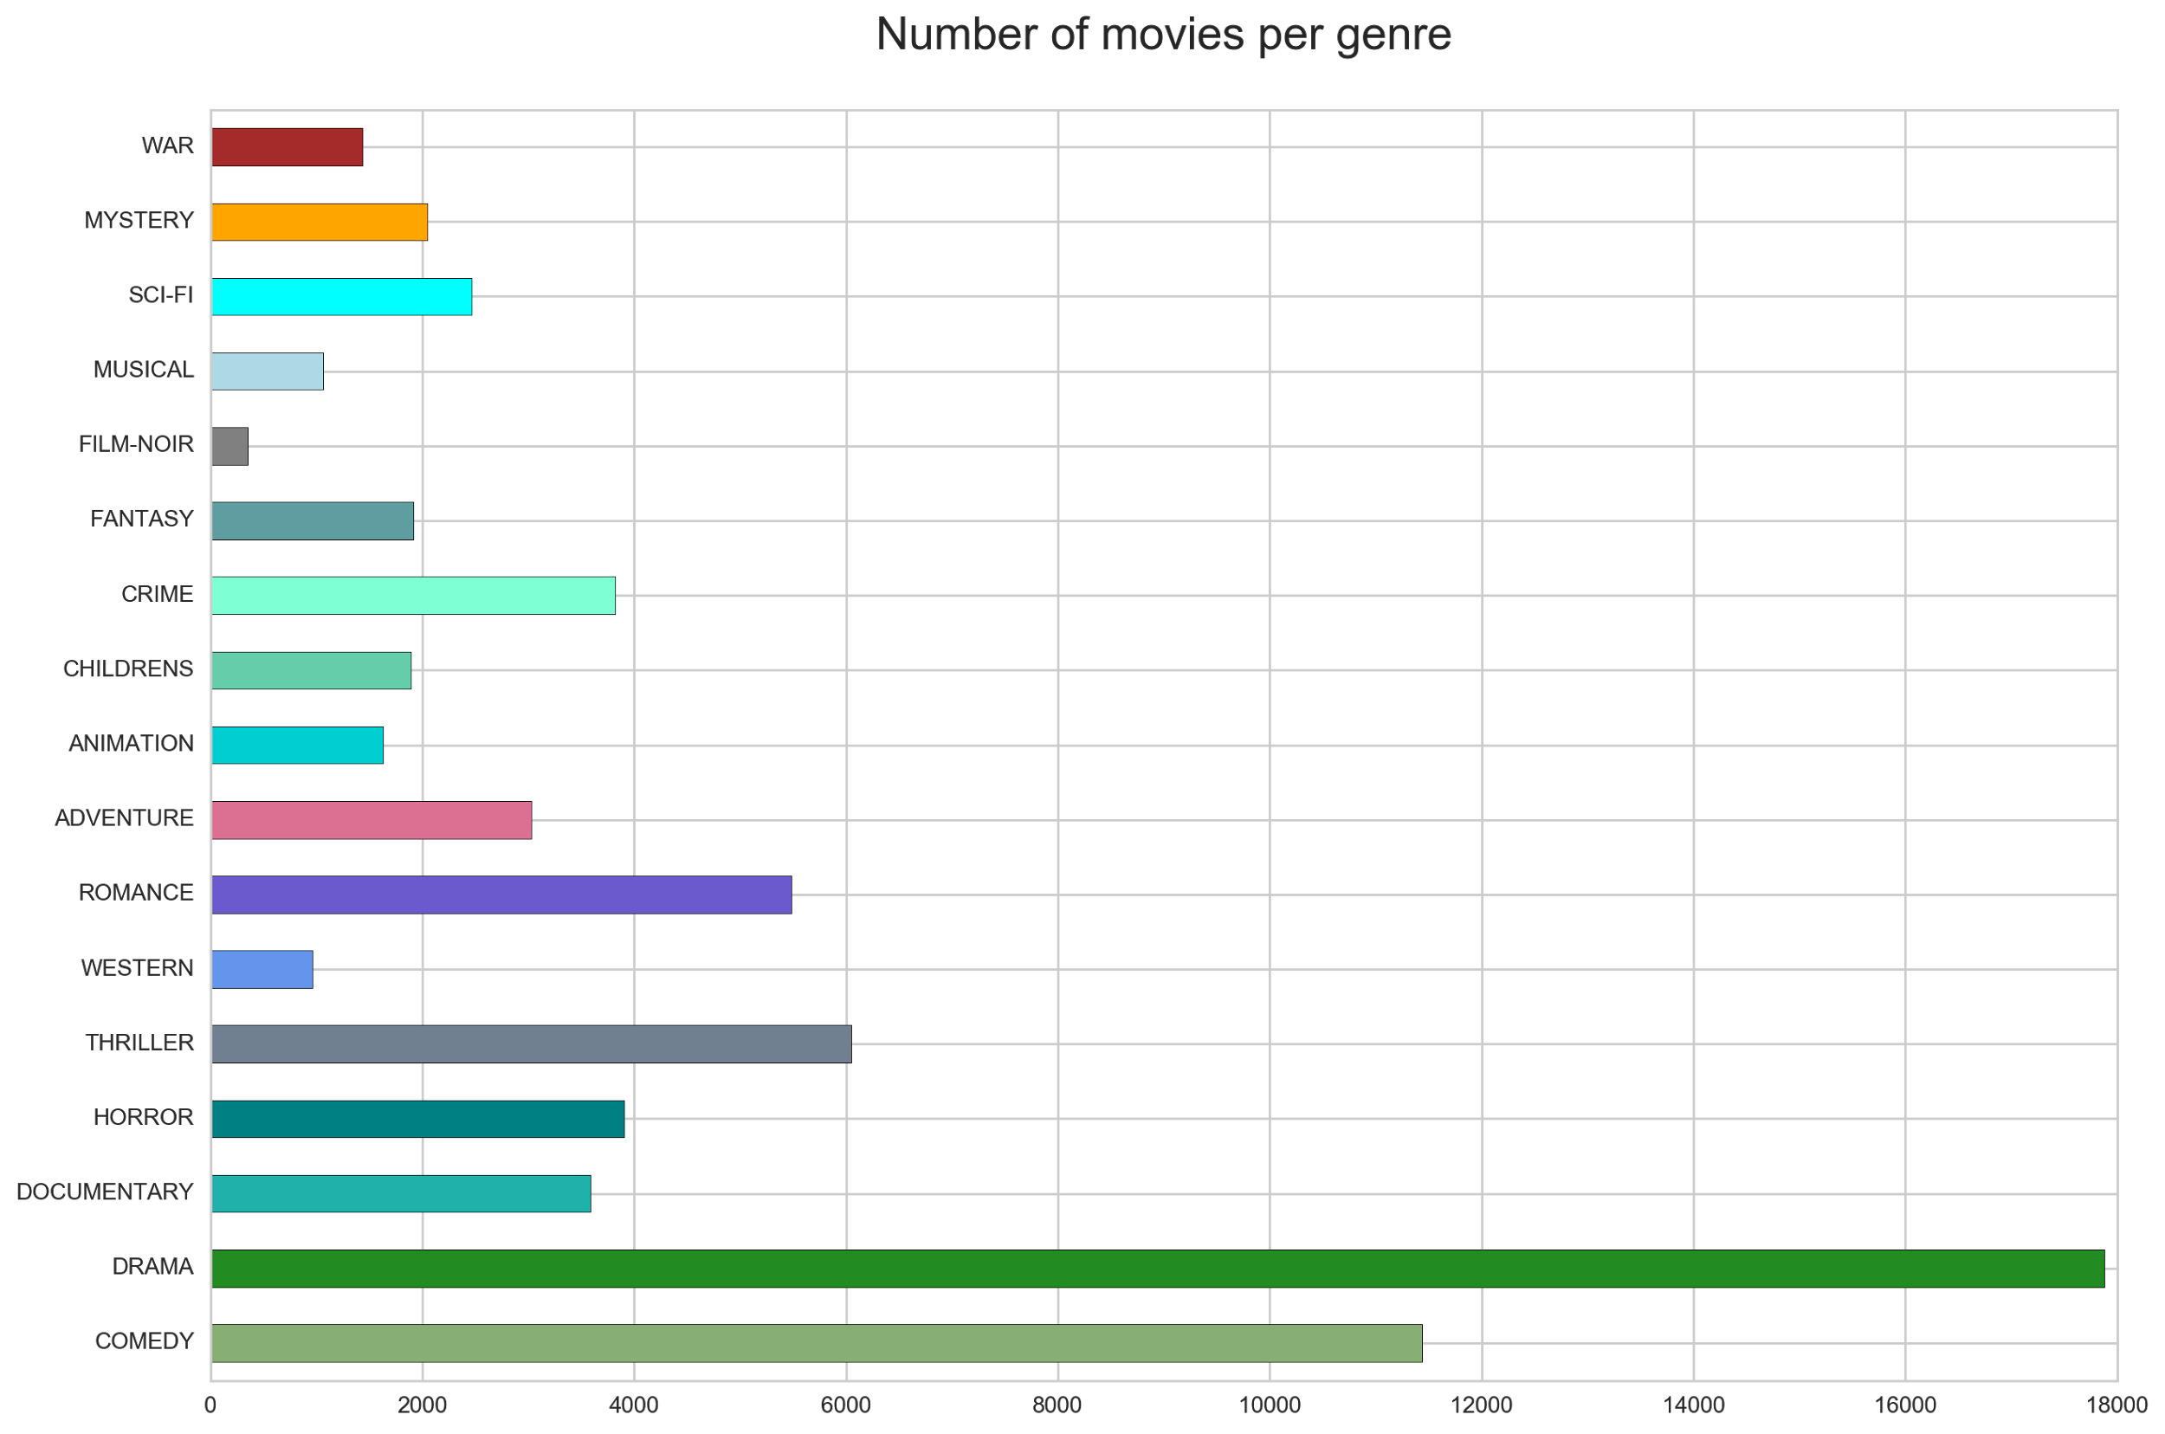

Slide 6
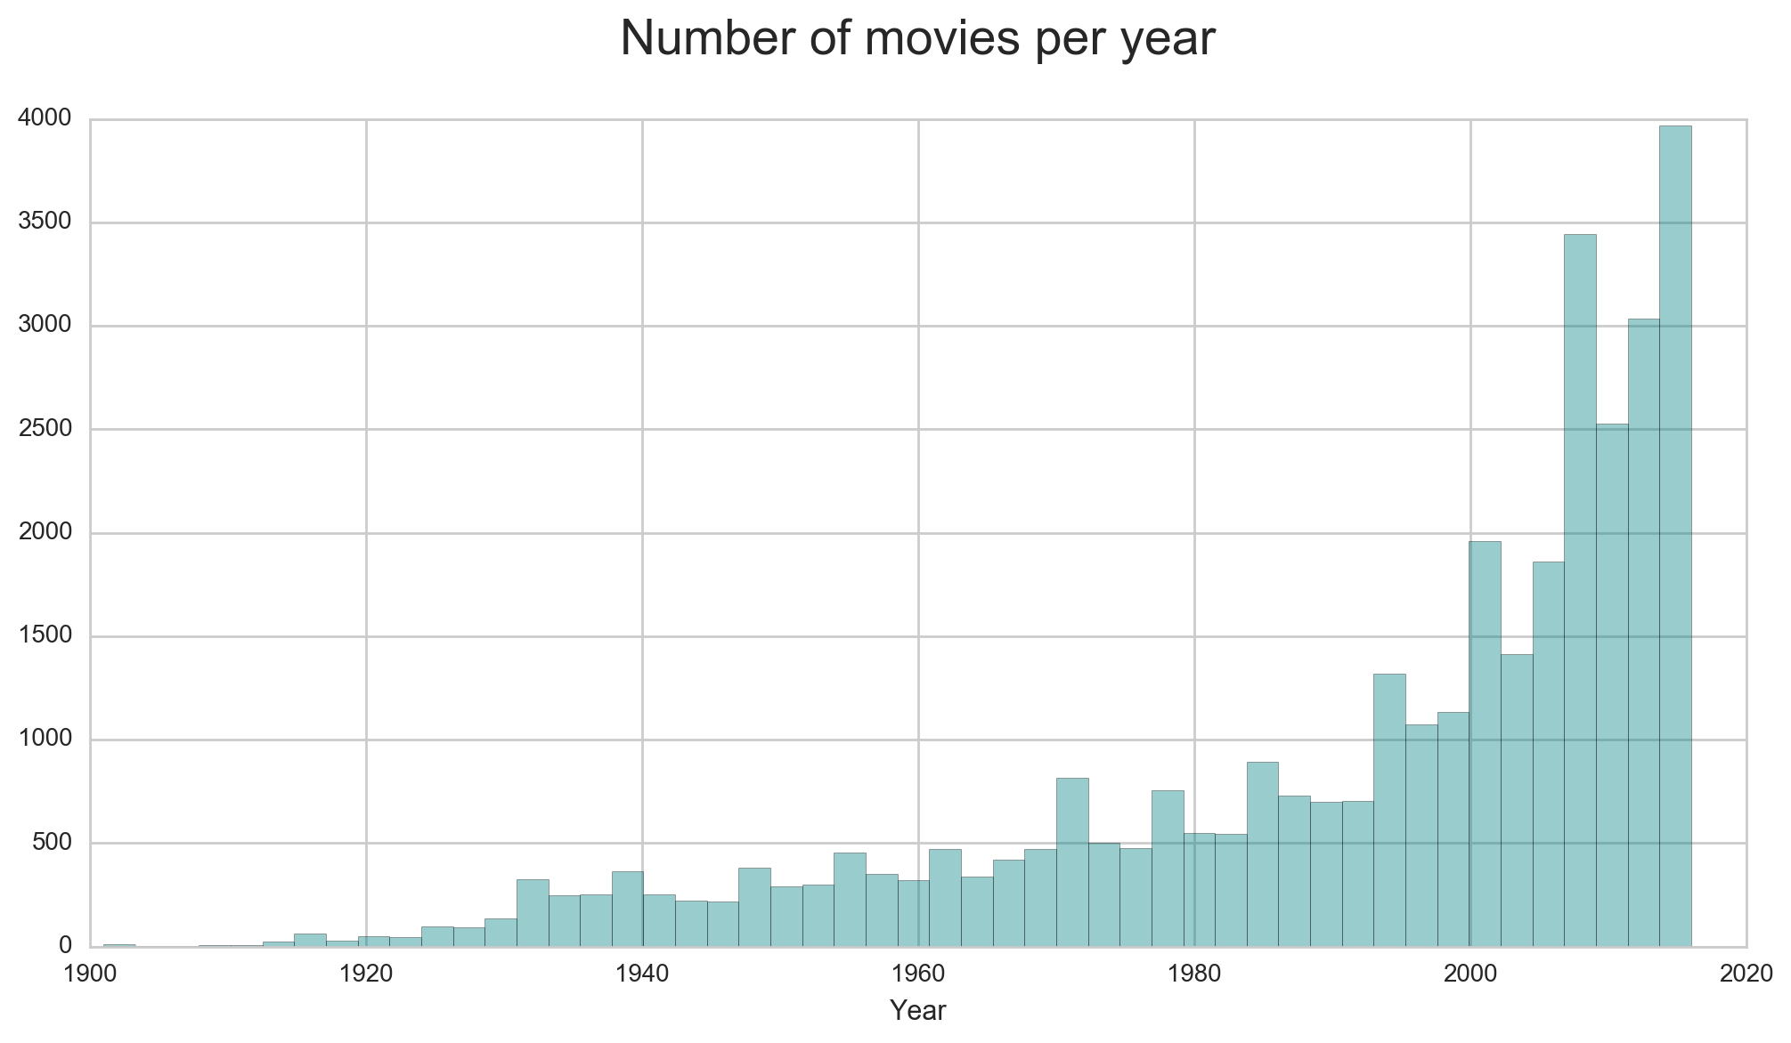

Slide 7
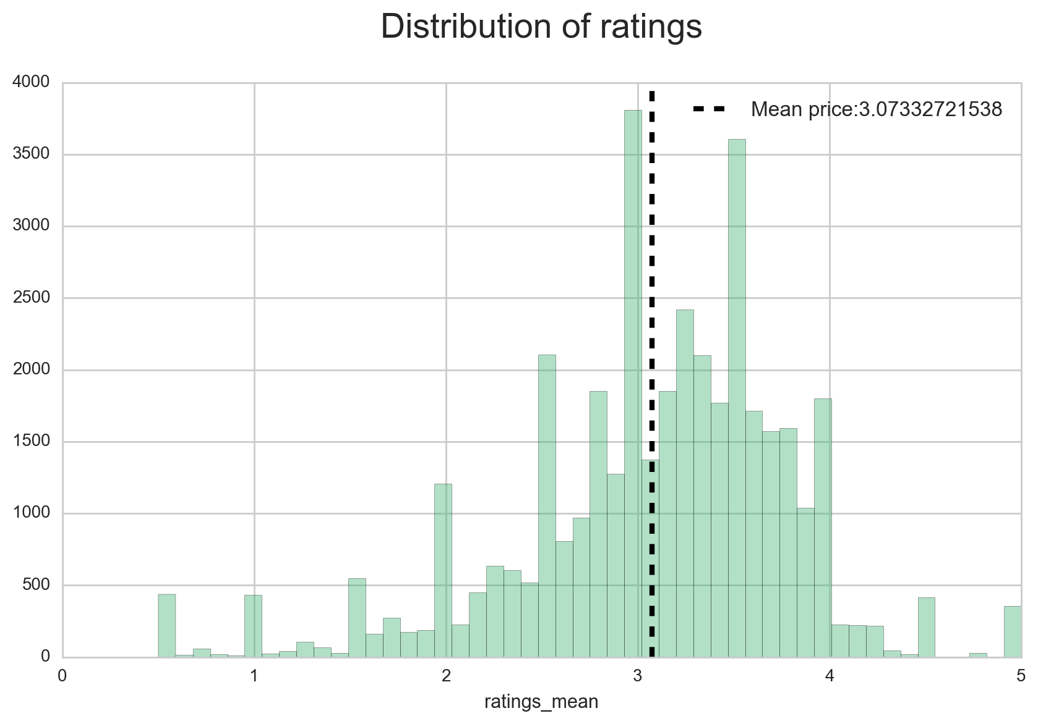

Slide 8
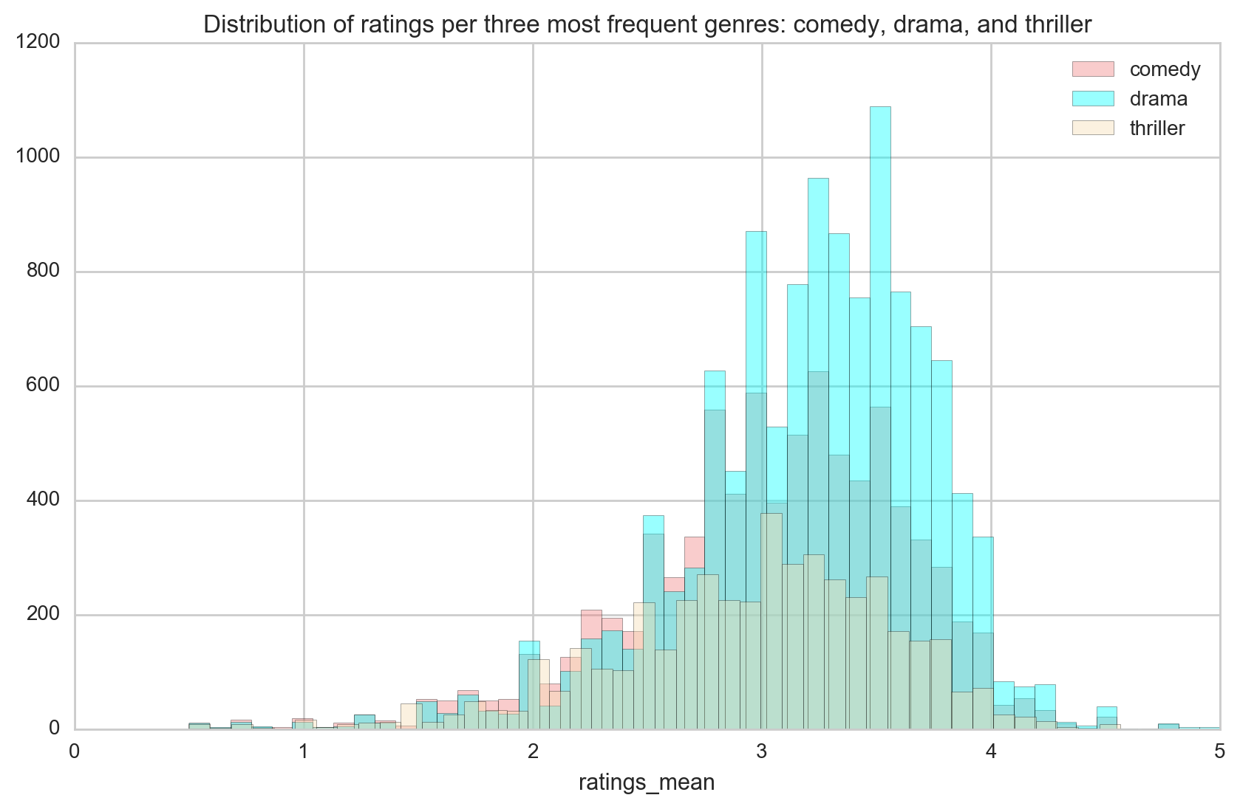

Slide 9
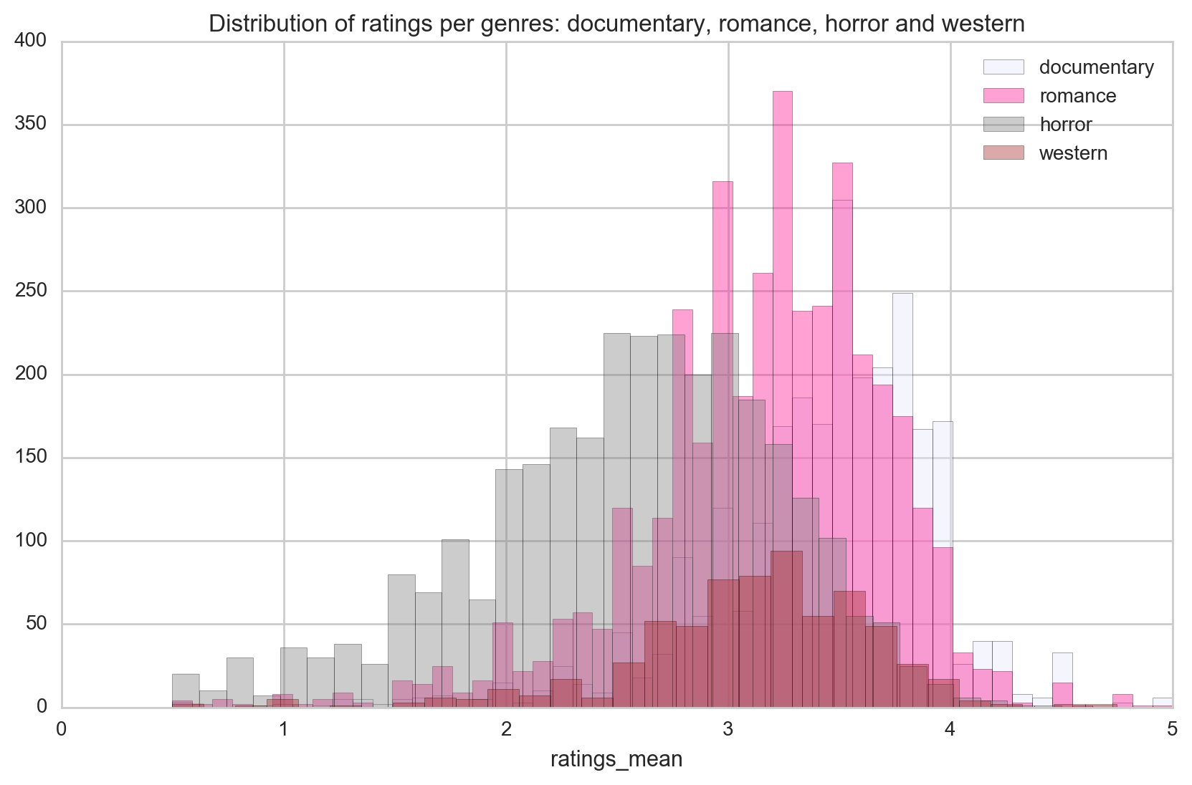

Slide 10
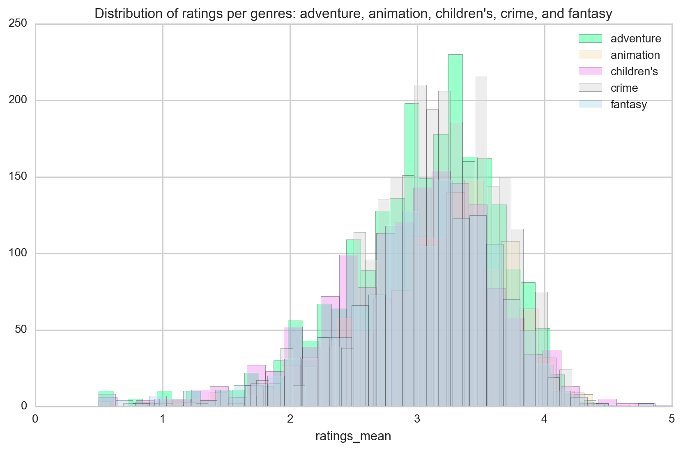

Slide 11
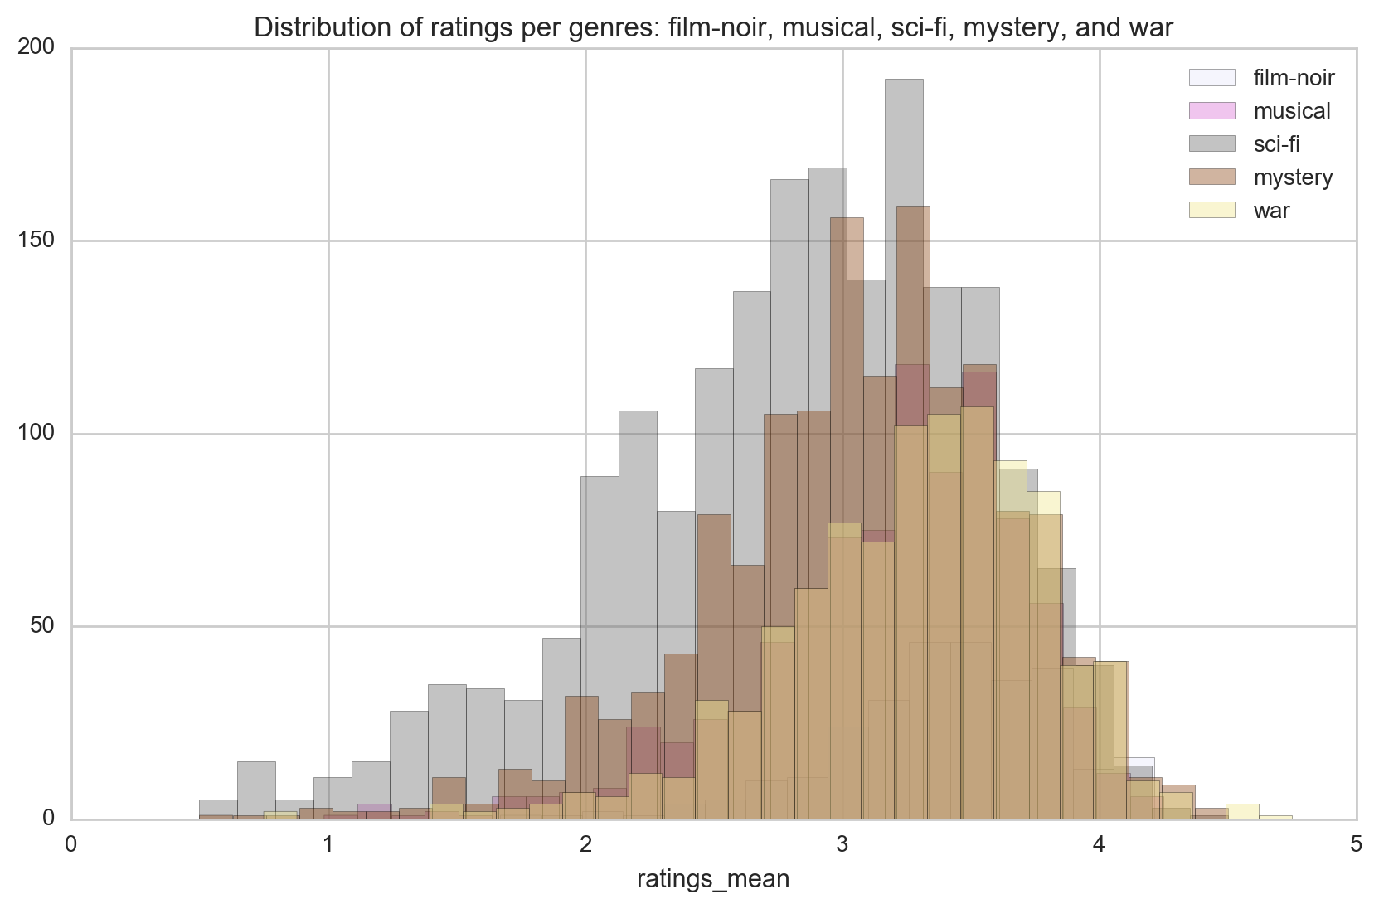

Slide 12
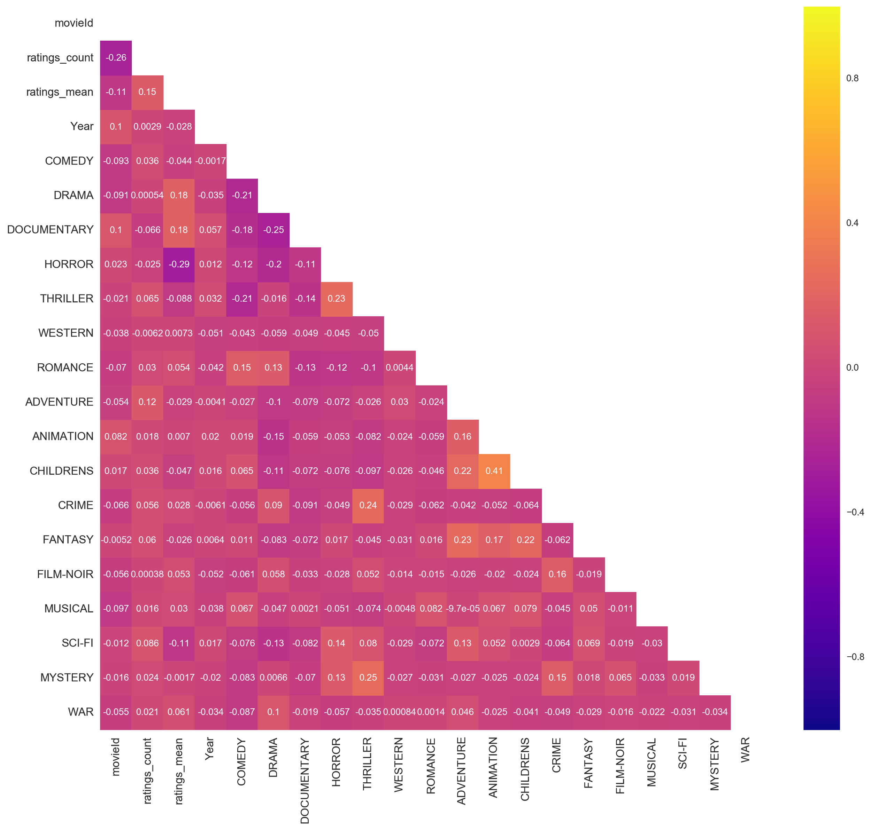

Slide 13
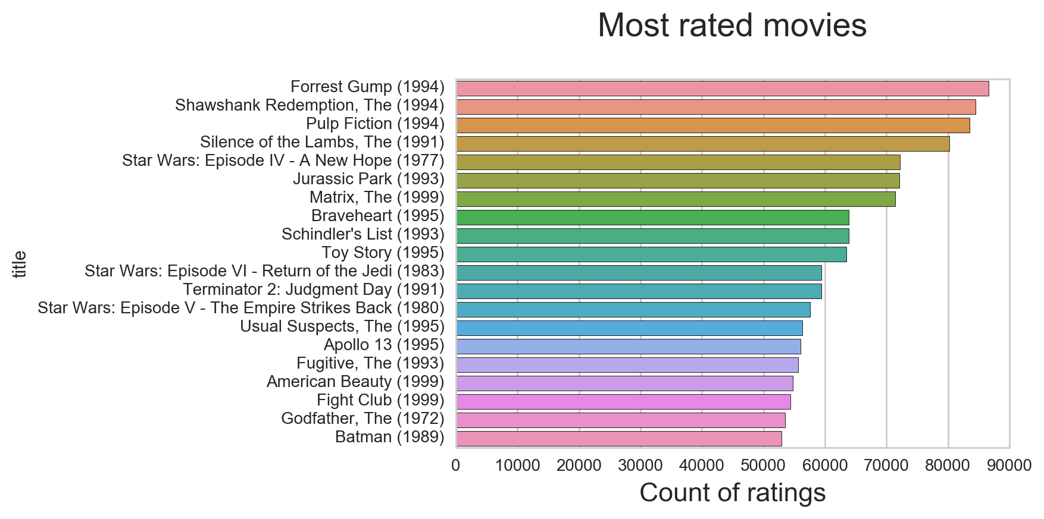

Slide 14
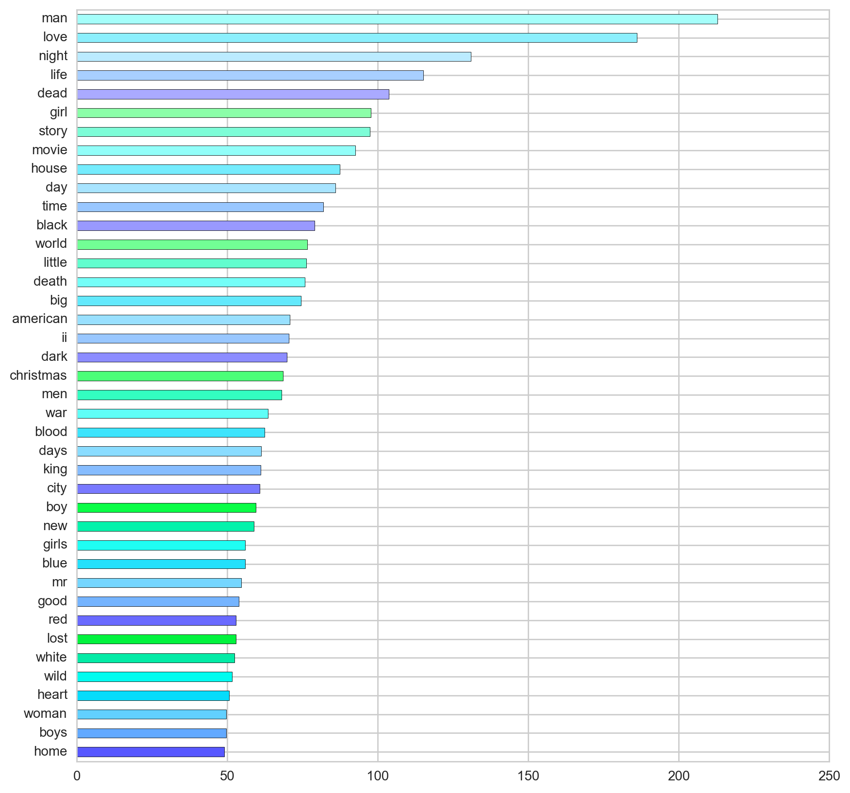

Slide 15


Slide 16
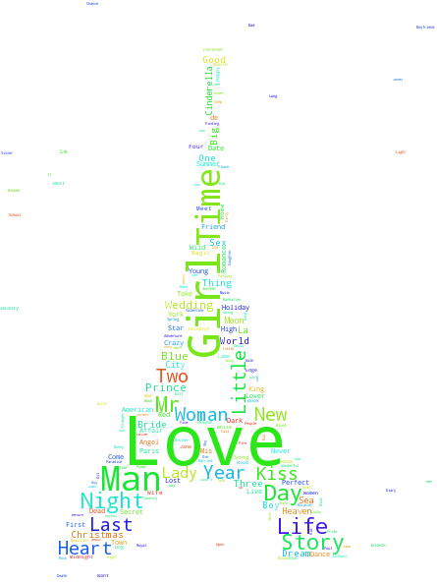

Slide 17
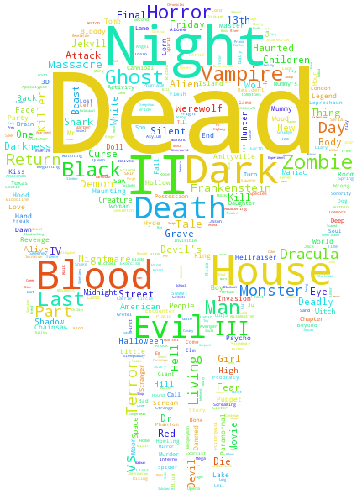

Slide 18
Genre prediction - One Versus Rest Classifier
Movies usually fall into more than one genre: I had to use multilabel classification
Multi Label Binarizer to preprocess the data into a binirized format, so the model could process the labels
Pipeline that consisted of the NLP feature extractions Count Vectorizer that transforms a collection of movie titles to a matrix of token counts and also Tfidf Transformer, which creates a tf-idf representation from a count matrix(Count Vectorizer)
OneVsRestClassifier: fits one classifier per class. It associates a set of positive examples for a given class and a set of negative examples which represent all the other classes.

Slide 19
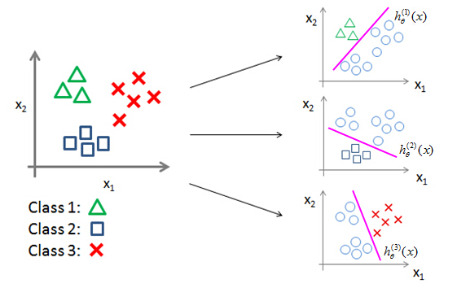
Genre prediction - One Versus Rest Classifier
Taken from:
http://m.blog.csdn.net/article/details?id=50685873
Inside the OnVsRest I used Linear Suppor Vector Classifier
-easy to compute
- effective in cases where number of dimensions(features) is greater than the number of samples
- supports OneVsRest

Slide 20
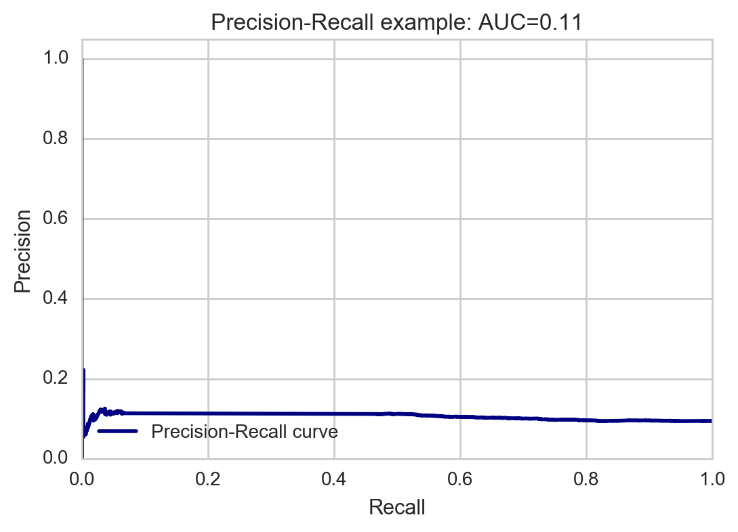
Genre prediction - One Versus Rest Classifier
Notes:
The precision/recall cure shows us the trade-off between precision (false positive rate) and recall (false negative rate). High scores for both show that the classifier is returning accurate results (high precision), as well as returning a majority of all positive results (high recall).

Slide 21
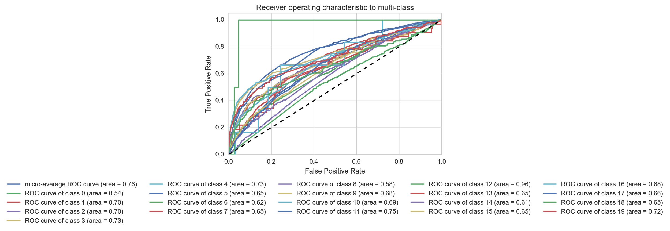
Genre prediction - One Versus Rest Classifier
Notes:
(0, '(no genres listed)') (1, 'action') (2, 'adventure') (3, 'animation') (4, 'children') (5, 'comedy') (6, 'crime') (7, 'documentary') (8, 'drama') (9, 'fantasy') (10, 'film-noir') (11, 'horror') (12, 'imax') (13, 'musical') (14, 'mystery') (15, 'romance') (16, 'sci-fi') (17, 'thriller') (18, 'war') (19, 'western')

Slide 22
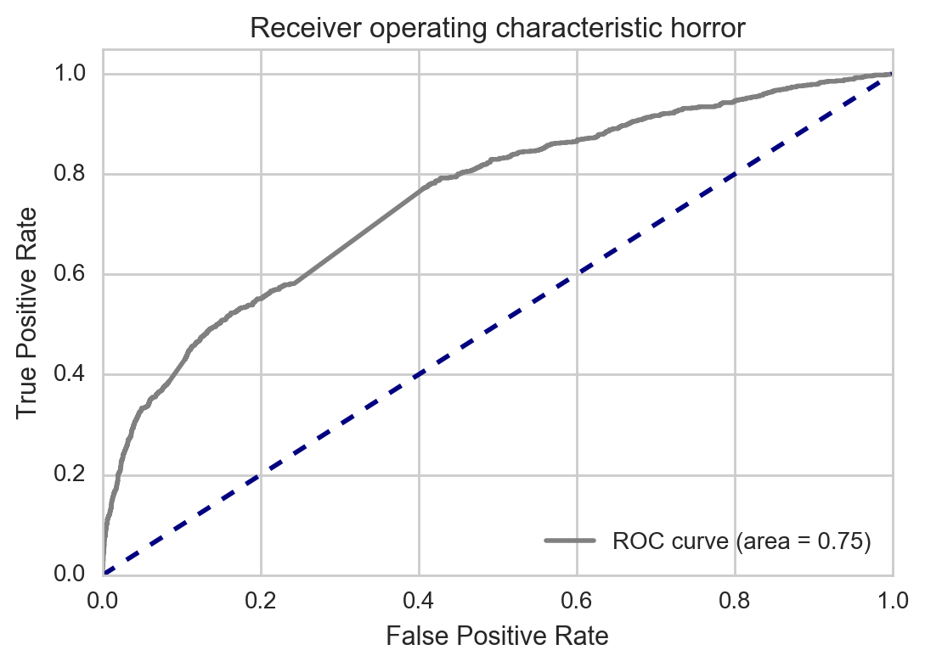
Genre prediction - One Versus Rest Classifier
Notes:
Receiving Operating Characteristic, or ROC, is a visual way for inspecting the performance of a binary classifier (0/1). In particular, it's comparing the rate at which your classifier is making correct predictions (True Positives or TP) and the rate at which your classifier is making false alarms (False Positives or FP).

Slide 23
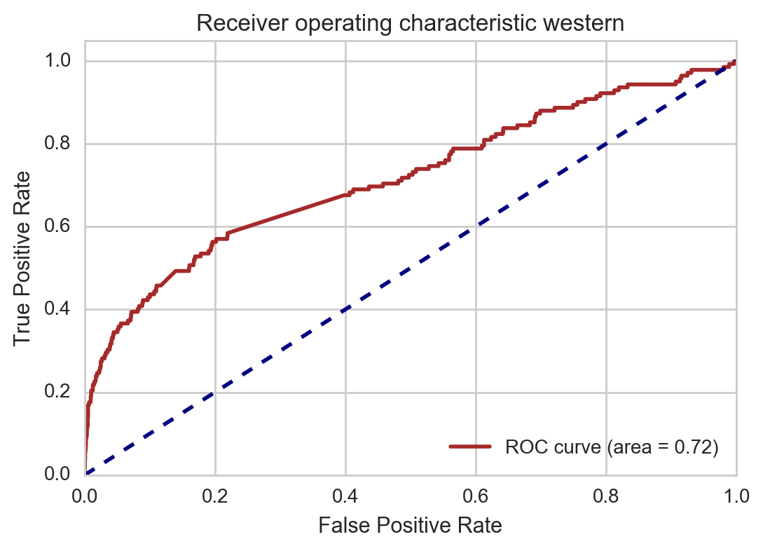
Genre prediction - One Versus Rest Classifier

Slide 24
Number of tested movies: 8622, number of at least one good classification: 3578 (41.5%)

Slide 25
Now let’s play:
'zombie in the forrest',
'death',
'kill your lady at night',
'die django ',
'frankenstein',
'love in paris',
'story of a novice',
'soldier in the battle and his army',
'alice in wonderland',
'peaky blinders',
'game of thrones',
'sex and the city',
'the big bang theory'
('comedy', 'horror'), ('action',), ('comedy',), ('thriller', 'western'), ('horror', 'sci-fi'), ('comedy', 'drama', 'romance'), ('documentary',), ('action', 'war'), ('adventure', 'fantasy'), ('drama',), ('drama',), ('comedy', 'drama', 'romance'), ('drama',)

Slide 26
Recommendation system:
Tf-idf again
Cosine similarity (genres, tags, and mean ratings)
Cosine similarity computes the cosine of the angle between the two vectors and returns normalized dot product (1 most similar)

Slide 27
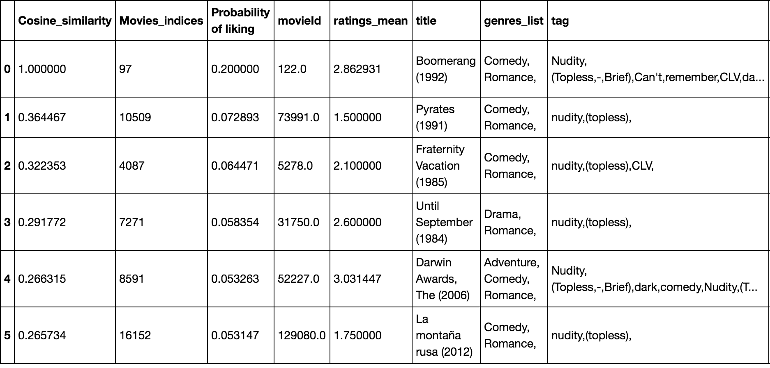
Recommendation system:

Slide 28
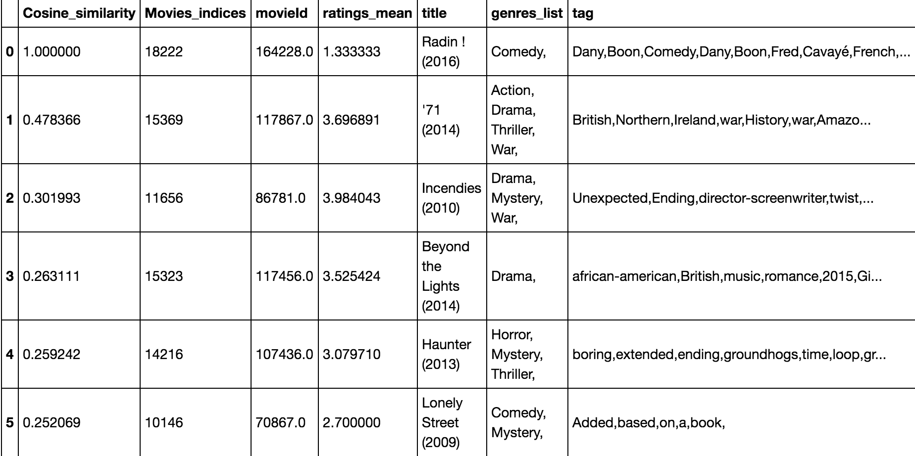
Recommendation system:

Slide 29
Conclusion:
Some genres are easier to predict than others, but the main problem is that genres are not mutually exclusive, but some predictions can be made
Recommendations are easier to assess when recommending according to one movie
To answer my question: recommendations can be done, but it is hard to evaluate them objectively (I will gladly try subjectively)

